Slide 1

Standard Data Systems
Steven Thompson
Standard Data Systems
© 2016 Institute of Industrial and Systems Engineers 3577 Parkway Lane Suite 200
Norcross, GA 30092
www.iienet.org
© 2016 Institute of Industrial and Systems Engineers
1

Slide 2
Objectives
Standard Data Systems
Define standard data systems
Determine advantages and disadvantages of standard data systems
Apply analytical tools to develop standard data models
Develop standard data models
Evaluate standard data models

Slide 3
Work Measurement Defined
Standard Data Systems
Work measurement is a systematic procedure that is employed to determine the time required to perform work tasks using the “best” method.
This time is called the Standard Time.

Slide 4

Methods of Measuring Work
Standard Data Systems
Estimation
Basic
Historical Data
SWAG
Direct Measurement
Time Study
Work Sampling
Physiological
Synthesis
Elemental Standard Data (Macro)
Predetermined Times (Micro)
Notes:
SWAG: Scientific Wild Ass Guess, and is a slang word meaning a rough estimate from an expert in the field, based on his/her experience

Slide 5
Microscopic Standard Data
(Pre-determined time systems) (PTS)
Standard Data Systems
Predetermined leveled times are established for basic body motions, such as reach, move, turn, grasp, position, release, disengage, and apply pressure. The analyst may obtain them from published standards in tabular or electronic forms, or the firm may develop its own.

Slide 6
Predetermined Time Systems Continued
Standard Data Systems
To use predetermined leveled times, the analyst must:
Clearly define and document the work design, including the best design of the work place, tools, tasks, and subtasks.
Select and document the source of the predetermined leveled times.
Identify and document the basic body motions involved in performing each subtask

Slide 7
Predetermined Time Systems Continued
Standard Data Systems
Assign times to the body motions required to complete each subtask and total assigned times to develop a leveled time for the subtask.
– Documentation should demonstrate that the accuracy of the original data base has not been compromised in application or standard development.
Total subtask times to develop a leveled time for the entire task.

Slide 8
Sample PTS Systems
Standard Data Systems
MTM
MOST
MODAPTS

Slide 9
Methods-Time Measurement (MTM)
Standard Data Systems
A procedure that analyses manual operations or methods into basic motions needed to perform it, and assigns each a pre-determined time based on the motion and environmental conditions

Slide 10
Time Measurement Units (TMU)
Standard Data Systems
1 TMU = 0.00001 hour
1 TMU = 0.0006 min
1 TMU = 0.036 sec
1 hour = 100,000 TMU
1 min = 1667 TMU
1 sec = 27.8 TMU

Slide 11
Maynard Operation Sequence Technique (MOST)
Standard Data Systems
Developed in 1980 by Zjell Zandin
Establishes standards at least 5 times faster than MTM-1, w/little if any sacrifice in accuracy
Concentrates on the movements of objects

Slide 12
MOST Procedure
Standard Data Systems
Watch job/task
Determine sequence(s) to use
Determine index values
Add index values to determine TMU
Multiply TMU by 10
Convert TMU to seconds, minutes, hours

Slide 13
Modapts
Standard Data Systems
MODAPTS divides manual work into three classes:
Transports, Terminal, and other motions.
– When used for manual assembly work, transports and terminal motions take virtually all of the task time.
In each case, the number represents a MOD, or
.129 seconds.

Slide 14
Standard Data Systems (SDS)
Standard Data Systems
Standard data systems (or elemental standard data) are developed for groups of motions that are commonly performed together, such as drilling a hole or painting a square foot of surface area. Standard time data can be developed using time studies or predetermined leveled times.
After development, the analyst can use the standard time data instead of developing an estimate for the group of motions each time they occur.

Slide 15
Standard Data Systems
Standard Data Systems
There are times when it is not practical to set standards with any direct measurement procedure.
High volume of different parts
Low production run
Rapid changeover

Slide 16
Standard Data
Standard Data Systems
Standard data expresses the relationship between certain pertinent characteristics of a task and the time required to perform that task, in a form that permits synthesis of the latter from the former.
Rather than determine the standard time for each job on the basis of an individual study, standard times from a number of related jobs may be organized into a data base from which the standard times for related jobs may be constructed or synthesized.
Marvin Mundel

Slide 17
Standard Data Applications
Standard Data Systems
Jobs similar in nature
Highly repetitive work
Jobs that have multiple standards due to combinations of variables
Long cycle time jobs that have repetitive elements within the long cycles
Indirect labor

Slide 18
Standard Data System Defined
Standard Data Systems
The normal time values for the work elements are usually compiled from previous direct time studies (DTS).
Using a standard data system, time standards can be established before the job is running.

Slide 19
SDS Advantages
Standard Data Systems
Increased productivity in setting standards
Associated costs savings
Capability to set standards before production
Avoids need for performance rating
Controversial step in direct time study
Consistency in the standards
Based on averaging of much DTS data
Inputs to other information systems
Product cost estimating, computer-assisted process planning, MRP

Slide 20
SDS Disadvantages and Limitations
Standard Data Systems
High investment cost
Developing a SDS requires considerable time and cost
Source of data
Large file of previous DTS data must exist
Methods descriptions
Documentation still required
Risk of improper applications
Attempting to set standard for tasks not covered by SDS

Slide 21
Steps to Develop SDS
Standard Data Systems
Define the objectives of the system
Written
Objectives
Tools
Accuracy
Define the coverage of the system
All tasks
Limited range
Family or groups of tasks specified

Slide 22
Steps to Develop SDS Continued
Standard Data Systems
3) Obtain work element normal time data
Common elements
Example: Consider a worker in a packing plant whose job is to remove a carton of fruit from a conveyor belt, stencil the name of the customer on the carton and carry to a nearby skid. The suggested breakdown of elements is
Lifting and position the carton Positioning stencil on carton
Applying a 10 cm brush and tar to stencil the name and address Lifting carton
Walking with carton Placing on skid
1.
2.
3.
4.
5.
6.

Slide 23
Steps to Develop SDS Continued
Standard Data Systems
Develop Coding System
Easy recognition, e.g., letters and numbers such as PNT10 indicating painting an area up to 10 square meters
Hierarchical with basic motions at lowest level
Frequencies

Slide 24
Steps to Develop SDS Continued
Standard Data Systems
Classify work elements
Major
Minor
Example: Consider an activity called restricted walking which is defined as starting at dead stop and ending at dead stop
Major factor would be distance covered.
Minor factors would include temperature, humidity, lighting
Determine relationships
Graphical
Analytical (Regression)

Slide 25
Steps to Develop SDS Continued
Standard Data Systems
Develop database
Charts
Formulas
Computerized
Prepare documentation
Development steps
Manual

Slide 26
Classification of Work Elements
Standard Data Systems
The database in a standard data system is organized by work elements. When the user retrieves a particular work element in the system, a normal time corresponding to that element is provided to the user.
Different categories of work elements must be distinguished in an SDS, similar to the way different work element types must be distinguished in direct time study.

Slide 27
Classification of Work Elements
Standard Data Systems
Classification of work elements is even more important in a standard data system because the normal time is a predicted value rather than an observed value, as in direct time study.
The classification of work elements in a standard data system must account for differences between the following element types:
Setup versus production elements
Constant versus variable elements
Worker-paced versus machine elements
Regular versus irregular elements
Internal versus external elements

Slide 28
Setup versus Production
Standard Data Systems
Setup elements - associated with activities required to change over from one batch to the next
Performed once per batch
Production elements - associated with the processing of work units within a given batch
Performed once per work unit

Slide 29
Constant and Variable Elements
Standard Data Systems
Constant elements - same time value in all time studies and tasks
Examples:
Replace cutting tool in tool post
Dial telephone number of customer
Variable elements - same basic motion elements but normal times vary due to differences in work units
Examples:
Load work piece into machine
“Keypunch” address

Slide 30
Operator-Paced vs. Machine Elements
Standard Data Systems
Operator-paced elements - manual elements
Can be setup or production cycle elements
Can be constant or variable
Machine-controlled elements - machine time depends on machine operating parameters
Once parameters are set, the machine time can be determined with great accuracy
Characterized by little or no random variations

Slide 31
Other Work Element Differences
Standard Data Systems
Regular elements - performed once every cycle
Irregular elements - performed less frequently than once per cycle
– Must be prorated in regular cycle
External elements - manual elements performed in series with machine elements
Internal elements - manual elements performed at same time machine is running

Slide 32
Regression Models for Standard Data
Standard Data Systems
“Statistical formula development provides better analysis, is less costly to apply, is easier to sell to workers, and is easier to maintain than static
data.”
Willard Kern, In Search of Scientific Management

Slide 33
Regression Models
Standard Data Systems
Linear Bivariate
Linear Multivariate
Curvilinear Bivariate

Slide 34
Linear Regression
Standard Data Systems
The regression equation is determined mathematically from data collected on a process.
The regression equation predicts a value for the dependent variable, y, from the independent variable x.

Slide 35
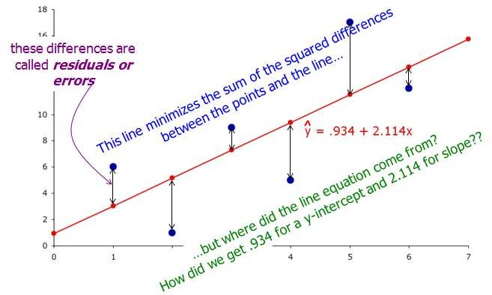
Least Squares Regression Model
Standard Data Systems

Slide 36
Linear Regression
Standard Data Systems
If there is a correlation the equation for that linear
relationship can be determined from the data.
y=b₀ +b₁x
In the equation above b₀ is the intercept and b₁ is the slope.
The intercept is where the curve crosses the y axis.
The slope is the change in y divided by the change in x
The values are calculated from the normal equations:

Slide 37
Normal Equations
Standard Data Systems
Determine slope (b₁) and intercept (b₀)
Developed from data
Solved simultaneously
∑y=nb₀ +b₁∑x
∑xy=b₀∑x+b₁∑x²

Slide 38
Regression Study
Standard Data Systems
Collect Data.
Determine independent and dependent variables.
Graph the data in a scatter diagram to determine if the data appears to be a straight line. (Not an obvious curve.)
Proceed to analysis if the data is linear.
Consider transforming data if not.
Always be aware of outliers.

Slide 39
Example 1
Standard Data Systems
Traditionally the Zero Washer Company has manufactured a wide variety of different washers. They currently market eight different washers. All of these have the same outside diameter the same thickness and are made of the same material. The only difference between these different washers is the size of the inside diameters.
Zero washers has developed a set of time standards showing the time required to produce 1,000 washers of each different inside diameter. This data is shown on the next page and is included in your data set 1.
The price of a new model washer was almost entirely dependent on the labor required to manufacture it. The labor cost was dependent on the time required to manufacture it. The major activity will obviously be time to remove material.

Slide 40
Washer Data
Standard Data Systems
Model | ID | Hours/1000
A1 | 0.0625 | 0.60
A2 | 0.1250 | 0.65
A3 | 0.2500 | 0.70
A4 | 0.3750 | 0.76
A5 | 0.5000 | 0.82
A6 | 0.7500 | 0.97
A7 | 0.6250 | 0.90
A8 | 0.8750 | 1.03

Slide 41
Developing the Relationship Using Regression
Standard Data Systems
Time is the dependent variable. ID is the independent variable
Develop scatter diagram
If “straight” determine relationship
Evaluate relationship
A check sheet shows the percentage difference between the predicted and observed times
We will use Excel to perform these tasks. First step is to construct a scatter diagram.

Slide 42
Scatter Diagram
1.20
Standard Data Systems
1.00
0.80
Hours/Thousand
0.60
0.40
0.20
0.00
0.0000 0.1000 0.2000 0.3000 0.4000 0.5000 0.6000 0.7000 0.8000 0.9000 1.0000
Diameter

Slide 43
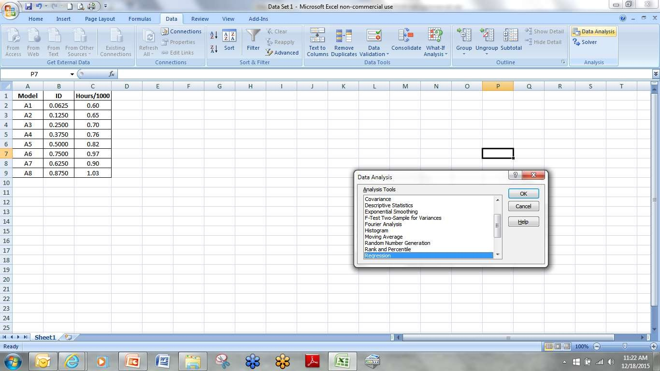
Regression Output
Standard Data Systems

Slide 44
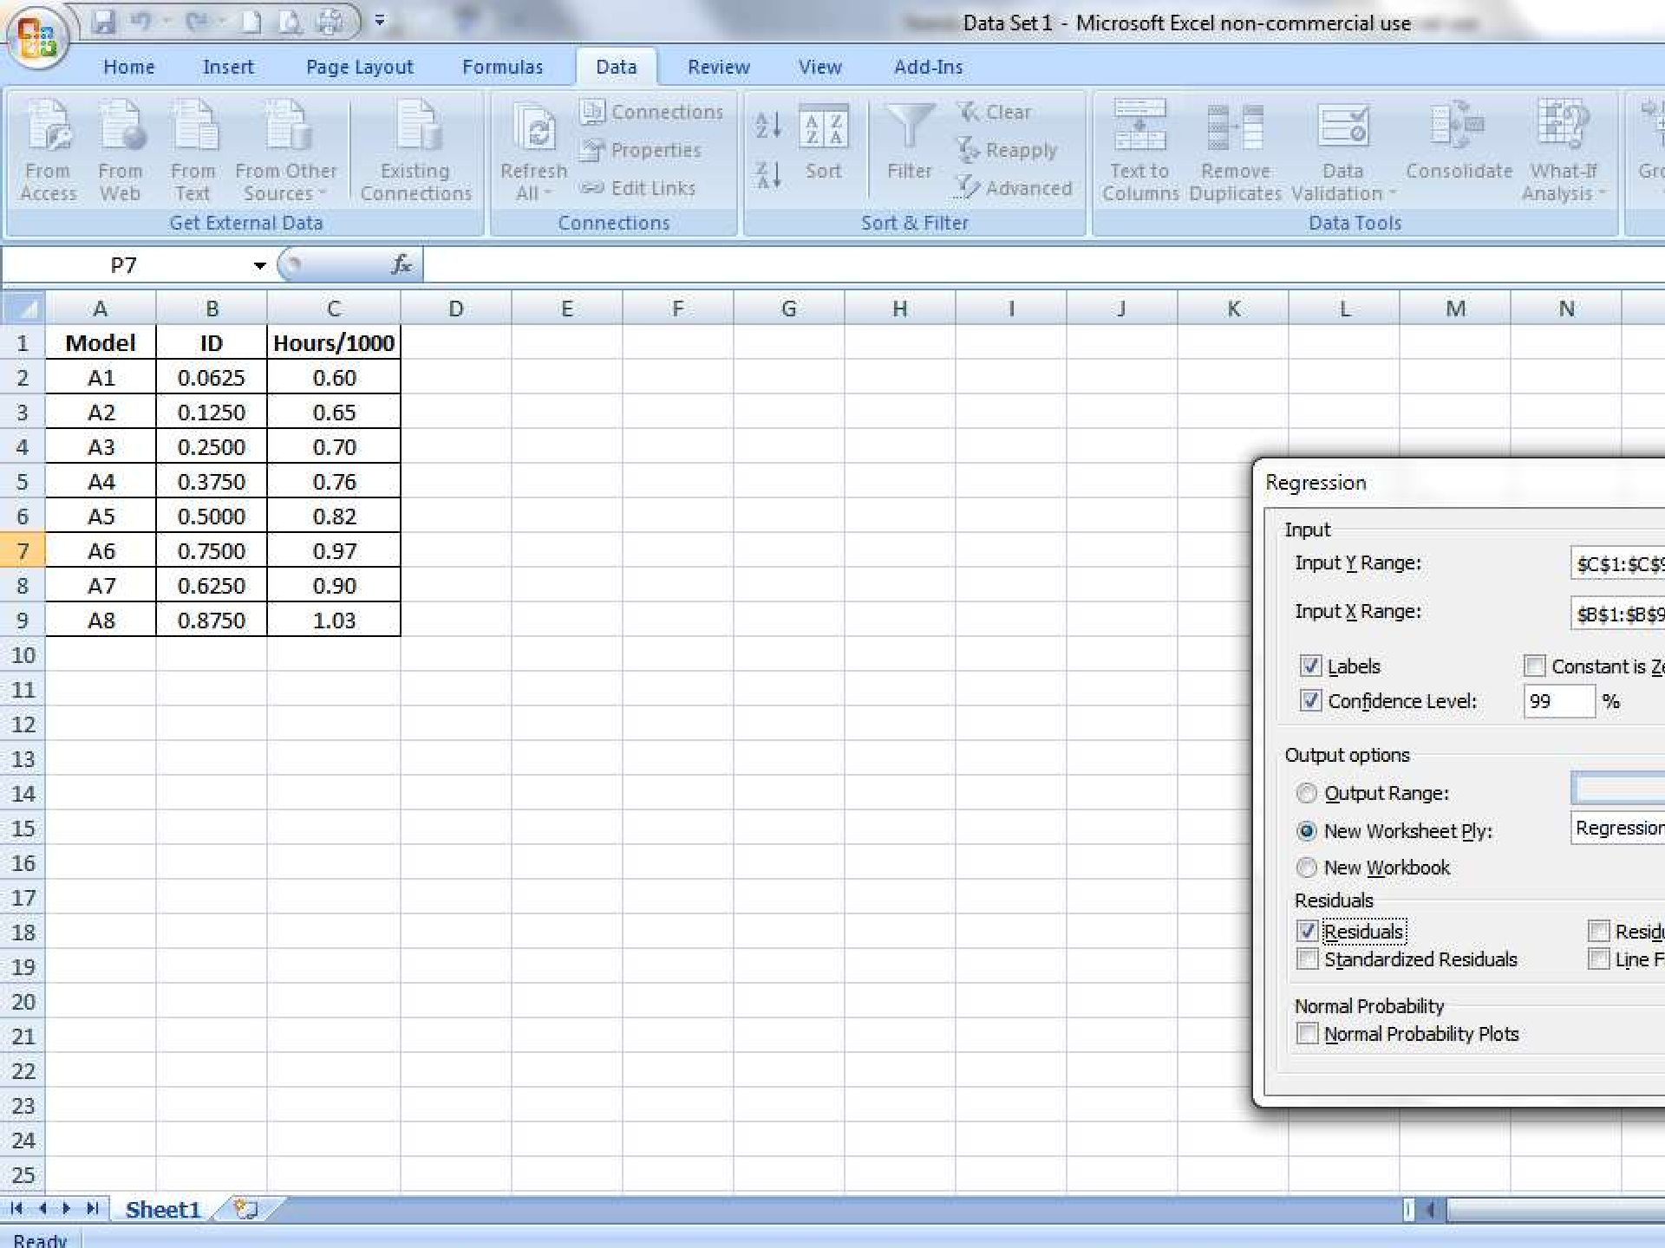
ems
t
s
y S
a t
Da d
andar St
© 2016 Institute of Industrial and Systems Engineers 44
Data Range
Labels for columns and 99 percent confidence
Select residuals

Slide 45
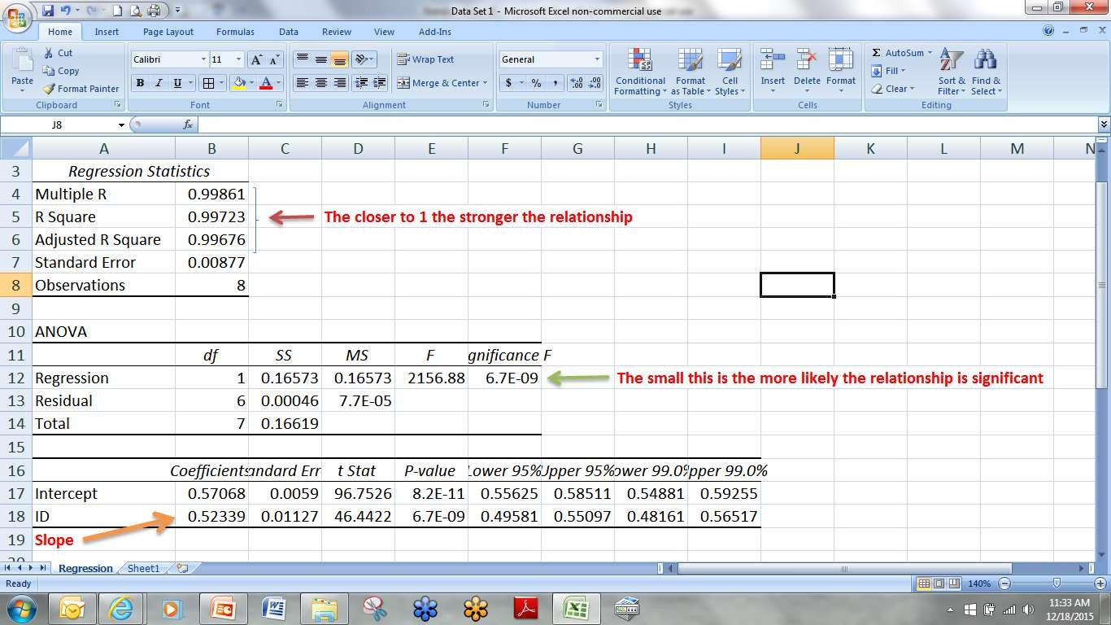
Computer Output
Standard Data Systems
Confidence Interval for Slope and Intercept

Slide 46
Interpreting Results
Standard Data Systems
Equation: Time = .57 + .523(ID)
Can now generate time for any washer within the range.
To demonstrate how “good” the results are the residuals can be used to construct a check sheet.

Slide 47
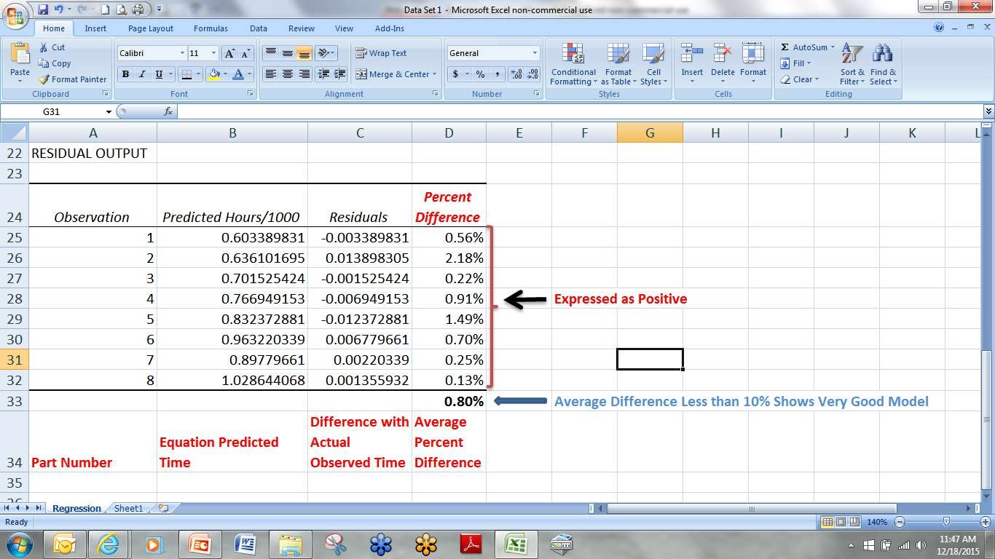
Check Sheet
Standard Data Systems

Slide 48
Multiple Factors
Standard Data Systems
More than one major factor
Example: Take the case of a motor driven circular saw used for cross cutting wood (all of the same type.) Factors influencing the time include-
Variation in thickness of the wood
Variation in the width of the wood
Temperature
Humidity
Lighting
Fixture
Experience of operator
Which of these would be major factors?

Slide 49
Example 2
Standard Data Systems
Having identified two major factors develop the standard data system for
cutting wood.
Width of Thickness of Material Material 1 2 3 4
6 | 0.064 | 0.074 | 0.081 | 0.093
12 | 0.088 | 0.112 | 0.093 | 0.111
16 | 0.112 | 0.13 | 0.151 | 0.181
20 | 0.12 | 0.16 | 0.169 | 0.216

Slide 50
Scatter Diagrams
Standard Data Systems
0.1
0.2
0.08
0.15
Time
0.06
0.04
Time 0.1
16 Inch Thickness
_{0.02} 6 Inch Width
0.05
0
2 3
Thickness
0
0
1
4
5
0
1
2
3
4
5
Width
0.12
0.1
0.08
Time 0.06
0.04
0.02
0
0.250
0.200
12 Inch Width
Time
0.150
0.100
20 Inch Width
0.050
0
1
2 3
Thickness
4
5
0.000
2 3
Thickness
0
1
4
5

Slide 51
Model
Standard Data Systems
Linear relationship between time and width for all thicknesses suggests multiple linear regression to build time formula.
Time is a function of width and thickness.
y=b₀ +b₁x₁ +b₂x₂ +b₃x₃

Slide 52
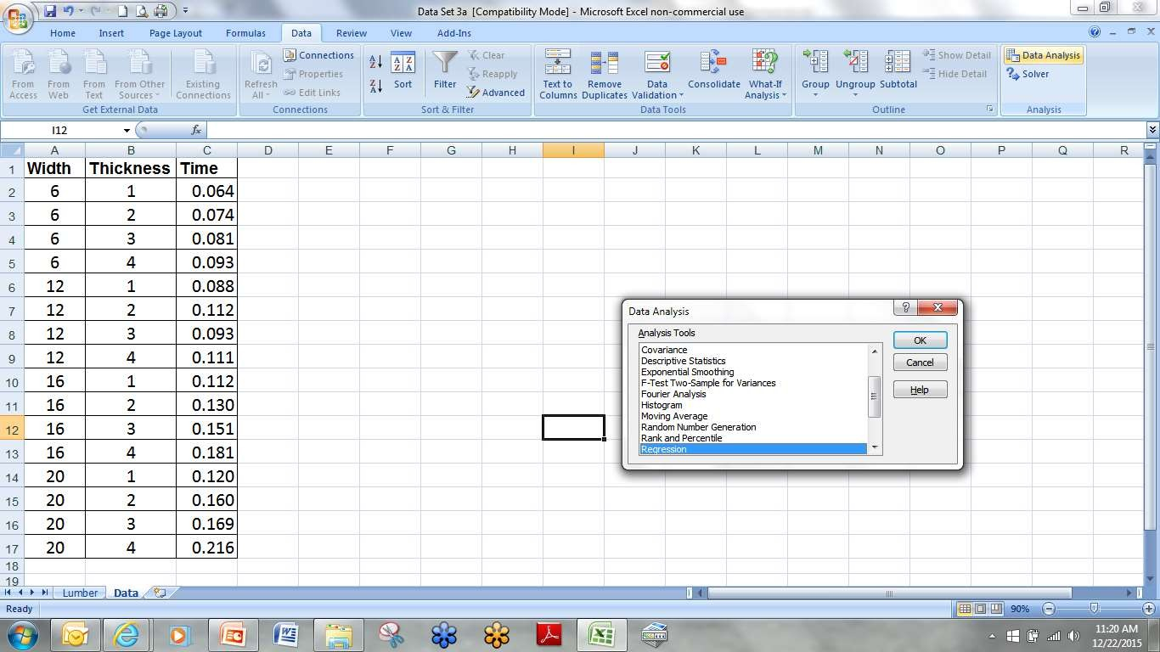
Excel Application
Standard Data Systems

Slide 53
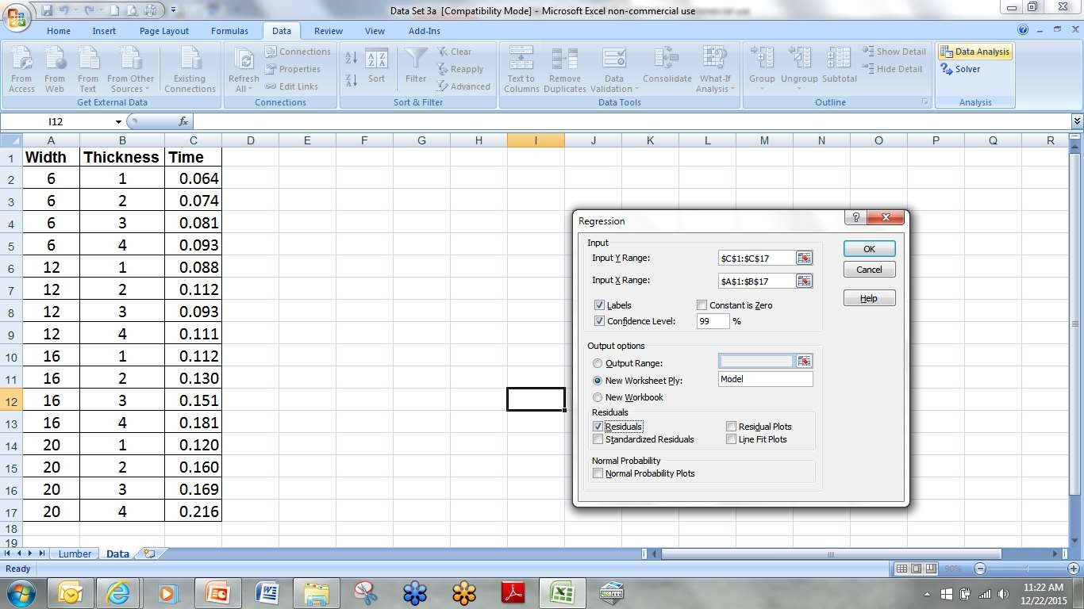
Excel Continued
Standard Data Systems
Input
Labels and Confidence
Residuals Checked

Slide 54
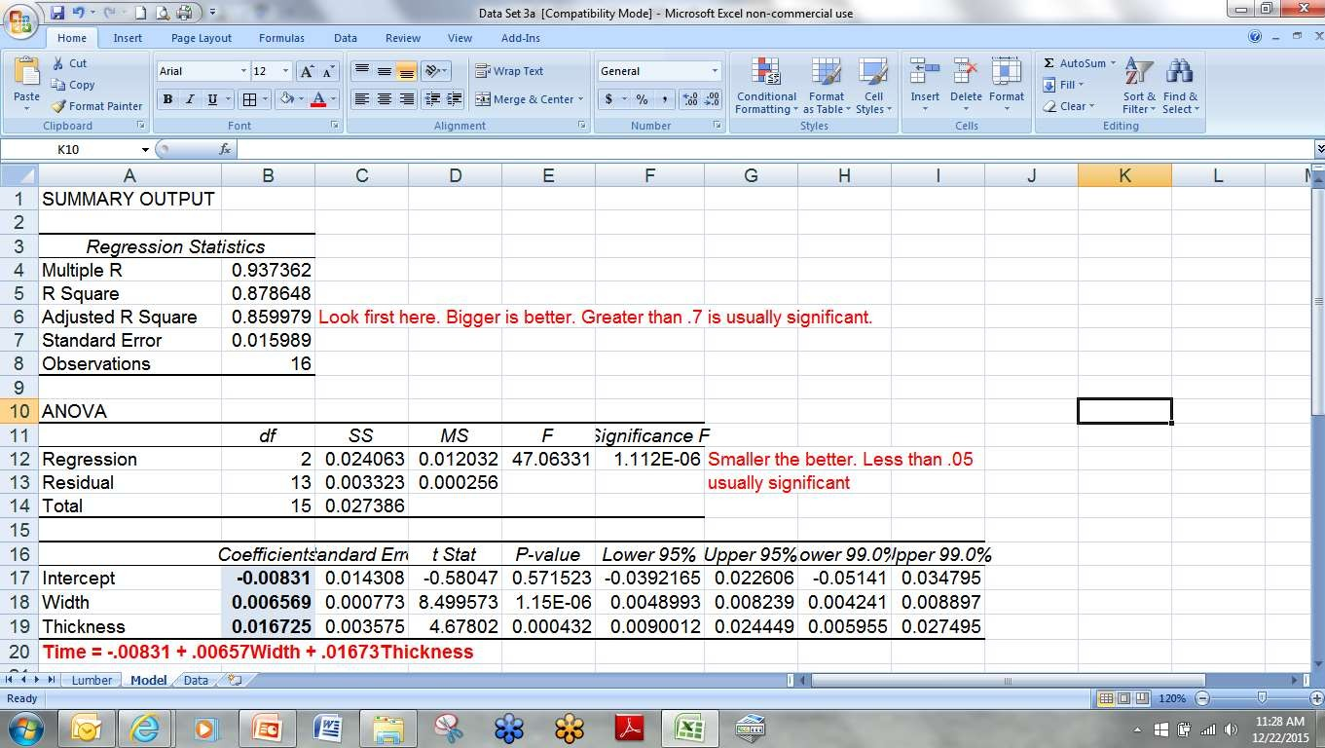
Excel Analysis
Standard Data Systems

Slide 55
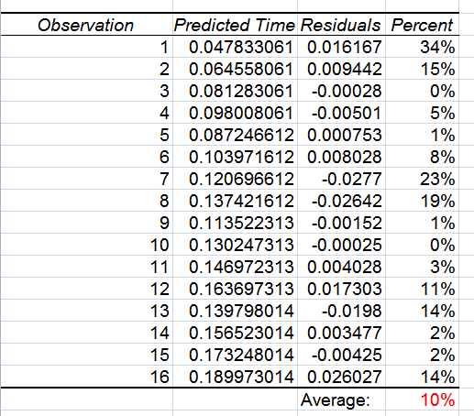
The Check Sheet
Standard Data Systems
How long should it take to cut a board that is 3.5 inches thick and 14 inches wide?

Slide 56
Curvilinear Regression
Standard Data Systems
Determines the relationship between one dependent and one independent variables when the relationship is not linear
Transform data
Proceed as if linear
High correlation does not necessarily imply a cause effect relationship
1-7-

Slide 57
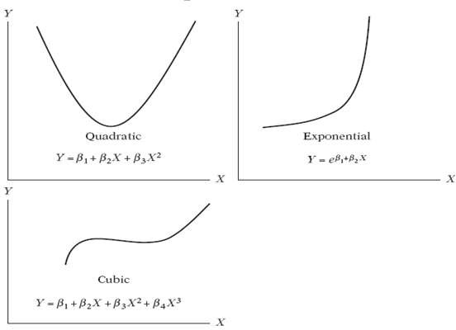
Typical Curvilinear Models
Standard Data Systems
1-7-

Slide 58
Curvilinear Regression Normal Equations
Standard Data Systems
y=b₀ +b₁x+b₂x²
1-7-

Slide 59
Example - Curvilinear
Standard Data Systems
X Y
5 | 26
4 | 17
3 | 8
2 | 5
4 | 15
5 | 23
1 | 1
2 | 3
4 | 17
6 | 58
36
173
1-7-

Slide 60
Example Data Scatter Diagram
Standard Data Systems
70
60
50
40
30
20
10
Y Data
0
0 1
Appears to be a power
relationship.
2
3
4
5
6
7
X Data
© 2007 Institute of Industrial and Systems Engineers
7-60

Slide 61
Straighten Line
Standard Data Systems
Transform data
Try y = f(x²) or y = f(x³)
Draw scatter diagram
When appears straight find regression relationship

Slide 62
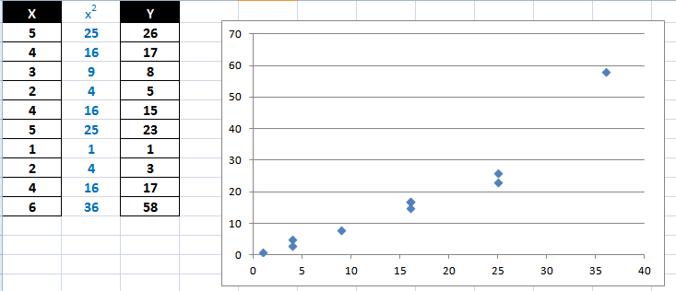
Trying y = f(x²)
Standard Data Systems
Not so straight.

Slide 63
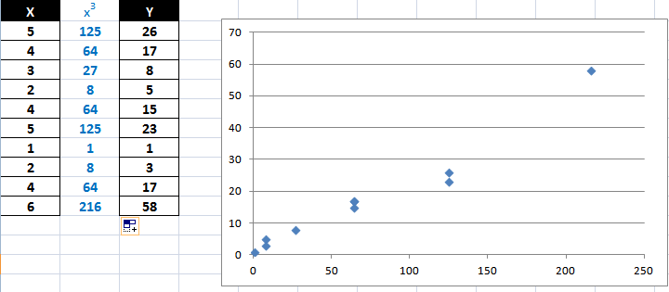
Trying y = f(x³)
Standard Data Systems
Straighter… close enough to find the regression line

Slide 64
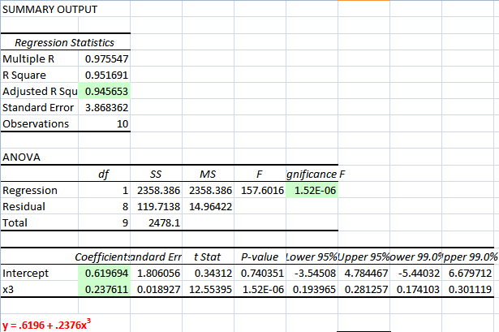
Equation Showing Cubic Relationship
Standard Data Systems

Slide 65
Using Formulas
Standard Data Systems
Prior to general use a definite and obvious declaration of the limits of the data provided including
Method
Equipment
Range of variables (no extrapolation)

Slide 66
Another Example
Standard Data Systems
Product family similar
Existing time standards
Similar Process

Slide 67
Example 3
Standard Data Systems
Model
Element Code | 119 | 130 | 220 | 310 | 311 | 322 | 329
10 | 0.24 | 0.22 | 0.23 | 0.23 | 0.24 | 0.22 | 0.23
20 | 0.38 | 0.35 | 0.35 | 0.37 | 0.36 | 0.36 | 0.37
30 | 12.06 | 10.44 | 8.71 | 6.58 | 10.83 | 6.34 | 7.25
40 | 3.66 | 4.81 |  | 2.79 | 5.84 | 4.55 | 4.10
50 |  | 1.63 | 1.91 | 1.69 | 1.80 | 1.45
60 | 0.12 | 0.12 | 0.13 | 0.11 | 0.14 | 0.14 | 0.13

Slide 68
Brief Element Descriptions
Standard Data Systems
Element Code | General Description
10 | Insert Material
20 | Align
30 | Drill Hole
40 | Cut to Length
50 | Finish Surface
60 | Remove Material

Slide 69
Preliminary Review
Standard Data Systems
Elements 10, 20, and 60 all appear to be constant.
Elements 30, 40, and 50 require more information. Data Set 5 has additional process time data.
 | Model
Element Code | 119 | 130 | 220 | 310 | 311 | 322 | 329
10 | 0.24 | 0.22 | 0.23 | 0.23 | 0.24 | 0.22 | 0.23
20 | 0.38 | 0.35 | 0.35 | 0.37 | 0.36 | 0.36 | 0.37
30 | 12.06 | 10.44 | 8.71 | 6.58 | 10.83 | 6.34 | 7.25
40 | 3.66 | 4.81 |  | 2.79 | 5.84 | 4.55 | 4.10
50 |  | 1.63 | 1.91 | 1.69 | 1.80 | 1.45
60 | 0.12 | 0.12 | 0.13 | 0.11 | 0.14 | 0.14 | 0.13

Slide 70
 |  | Additional Data (Data Set 5)
Element
Code: | 30 | Drill Hole
Product | Time | Diameter Thickness
119 |  | 12.06 0.35 0.14
130 |  | 10.44 0.32 0.18
220 |  | 8.71 0.24 0.16
310 | 6.58 |  | 0.20 | 0.18 | Element | Finish
311 | 10.83 |  | 0.30 | 0.16 | Code: 50 Surface
322 | 6.34 |  | 0.16 | 0.21
329 | 7.25 |  | 0.18 | 0.20
 |  |  |  |  | Product Time Length Width Area
Standard Data Systems
119
Element Code:
Cut to 40 Length
130 | 1.63 | 4 | 0.25 | 1.00
220 | 1.91 | 8 | 0.50 | 4.00
310 | 1.69 | 5 | 0.25 | 1.25
311 | 1.80 | 10 | 0.25 | 2.50
322 | 1.45 | 1 | 0.50 | 1.00
329
Product
Time
Length
119 | 3.82 | 1.26
130 | 4.11 | 1.32
220
310 | 3.75 | 1.12
311 | 3.94 | 1.30
322 | 3.75 | 1.16
329 | 3.59 | 1.04

Slide 71
Use Regression to Develop Time Formulas
Standard Data Systems
30: t = 2.67 + 28.4Diameter – 5.1Thickness
40: t = 2.03 + 1.49Length
50: t = 1.482 + .116Area (Higher adjusted r
square)

Slide 72
Generating Times
Standard Data Systems
Times for all six elements must be used. Elements 10, 20 and 60 are constants regardless of the product characteristics as long as those elements occur.
Element 30 time is calculated using the hole diameter and material thickness.
Element 40 time is calculated using the length of the part to be cut.
Element 50 time is calculated using the area to be finished.
Overall predicted standard for any product would be the sum of the six element times.

Slide 73
Defining Elements
Standard Data Systems
Work elements must be defined for clear communication and consistent application.
Example:
An element may be called get. It should be defined as follows: Covers picking up and moving an object, or handful of objects, to a destination.
An object is any object handled, such as parts, hand tools, subassemblies, or completed articles as well as jigs, fixtures, or other holding devices.
A handful is the optimum number of objects which can be
conveniently picked up, moved and placed as required.

Slide 74
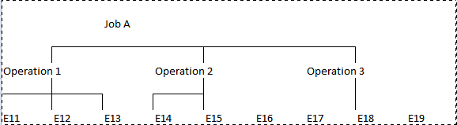
Computer Applications
Standard Data Systems
Allow application of data in hierarchical fashion
Original standards stored as elemental data
Operations are build by combining elements
Details
Frequencies

Slide 75
Presentation of Results
Standard Data Systems
Instructions
Limitations
Working Data
Tables
Graphs
Formulas
Documentation

Slide 76
Utilizing Standard Systems
Standard Data Systems
A company that produced military grade avionics products wanted to branch out into producing products for the consumer market.
Their previous attempts to estimate new product cost from existing data was not successful.
The closest they ever came to the actual cost was a 150% excess cost error.

Slide 77
Utilizing Standard Systems
Standard Data Systems
The main problem that they were encountering was not properly identifying and utilizing the proper data sets.
Once they completed the steps listed in the presentation, they recalculated their estimates.
This placed them within 10% of the actual cost.

Slide 78
Questions?
Standard Data Systems

